Slide 1

Strategies to Assess and Promote Student Wellness and Self-Care
Anisa Fornoff, pHarmD
She/Her/Hers
Associate Professor of Pharmacy Practice
Drake University
Clinical Pharmacist: Lutheran Behavioral Health Services
anisa.fornoff@drake.edu

Slide 2
Our discussion today
Many of us have recognized the increase in mental health issues on our campus. This session will focus on easy to implement wellness assessments, self-care activities, and communication strategies related to overall student well-being. Recognizing when to refer students to campus resources will be discussed. The session will also describe student wellness initiatives in the College of Pharmacy and Health Sciences.
Notes:
Seek new meaning – a take away.
Recognize some are not comfortable with this or you don’t think this is your job – so raise a flag in starfish.

Slide 3
Practice gratitude – every single day

Slide 4
Reflect
What is the definition of well-being?
Describe your overall well-being in 6 words or less
Share with a partner/group
Does your description match what you wish you could describe?

Slide 5
Wellness is defined as an active process of becoming aware of and making choices towards a healthy and fulfilling life.
Notes:
Intellectual wellness fosters active participation in mentally-stimulating activities that develop critical thinking skills, creativity, and openness to new ideas. Knowledge gained is used to improve the world around us.
Emotional wellness involves understanding your own feelings and expressing emotions in a constructive way. It is also the ability to manage stress and cope with life's challenges.
Social wellness embraces meaningful personal relationships, good communication skills, and respecting oneself and others. It fosters a campus community that values equity, diversity and inclusion.
Spiritual wellness nurtures a connection with something bigger than one’s self that cultivates a sense of meaning and purpose in life that aligns with one’s values, beliefs and everyday actions.
Physical wellness promotes taking care of our bodies to support optimal health through physical activity, healthy eating, and sleep, while avoiding the use of nicotine and abuse of drugs and alcohol.

Slide 6
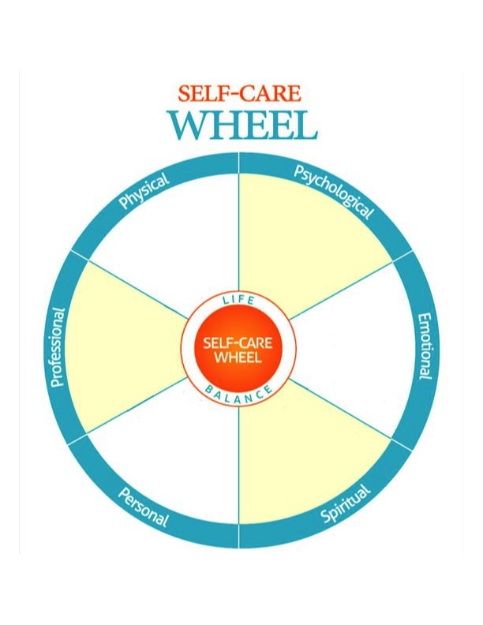

What are your core wellness strengths?

Slide 7
Drake CPHS Survey – Spring 2019
Total of 514 students completed survey
379 female, 133 male
Pre-Pharmacy/Pharmacy, Pre-OT/OT, Health Sciences: Clinical, Health Sciences: Health Management/Pre-AT
Lesson learned – many students are “somewhat aware” of services and “rarely” use resourses
Full data results not included in this handout.
Thank you to Chris Wing and Nora Stelter

Slide 8
Drake CPHS Survey – Spring 2019
Wellness is often thought of as just physical wellness or exercise and nutrition, but it is so much more. Wellness is defined as an active process of becoming aware of and making choices towards a healthy and fulfilling life.
The National Wellness Institute identifies six dimensions of wellness:
1) occupational/academic
2) physical
3) social
4) emotional
5) intellectual
6) spiritual
Notes:
Intellectual wellness fosters active participation in mentally-stimulating activities that develop critical thinking skills, creativity, and openness to new ideas. Knowledge gained is used to improve the world around us.
Emotional wellness involves understanding your own feelings and expressing emotions in a constructive way. It is also the ability to manage stress and cope with life's challenges.
Social wellness embraces meaningful personal relationships, good communication skills, and respecting oneself and others. It fosters a campus community that values equity, diversity and inclusion.
Spiritual wellness nurtures a connection with something bigger than one’s self that cultivates a sense of meaning and purpose in life that aligns with one’s values, beliefs and everyday actions.
Physical wellness promotes taking care of our bodies to support optimal health through physical activity, healthy eating, and sleep, while avoiding the use of nicotine and abuse of drugs and alcohol.

Slide 9
Drake CPHS - Initiatives
College student edition!

Slide 10
How inviting is your office ?
How fast do you ‘escape’ the classroom?
Where is your cell phone?

Slide 11
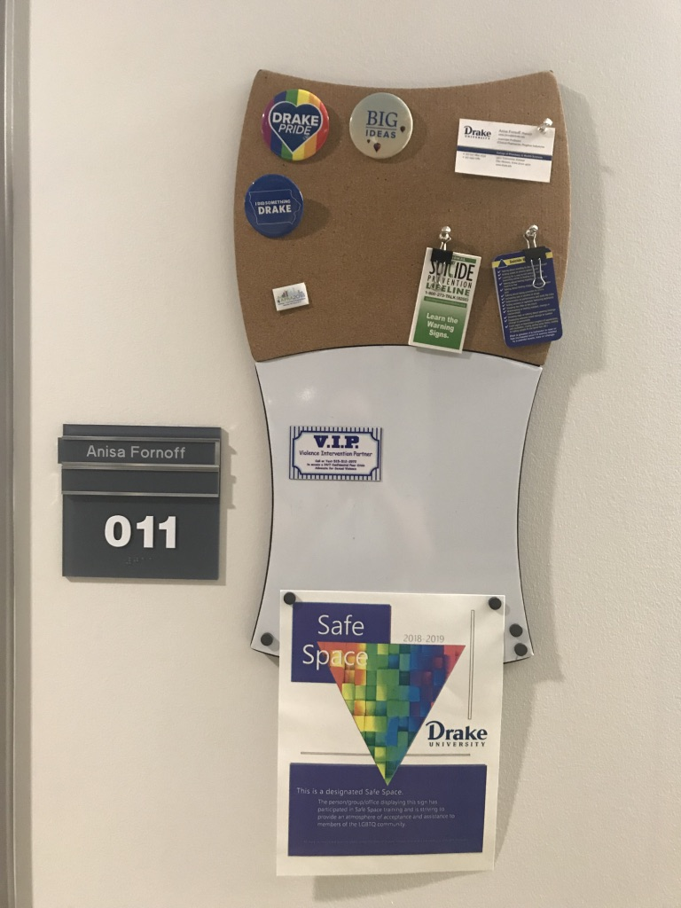
Opportunity to share info outside your office space

Slide 12
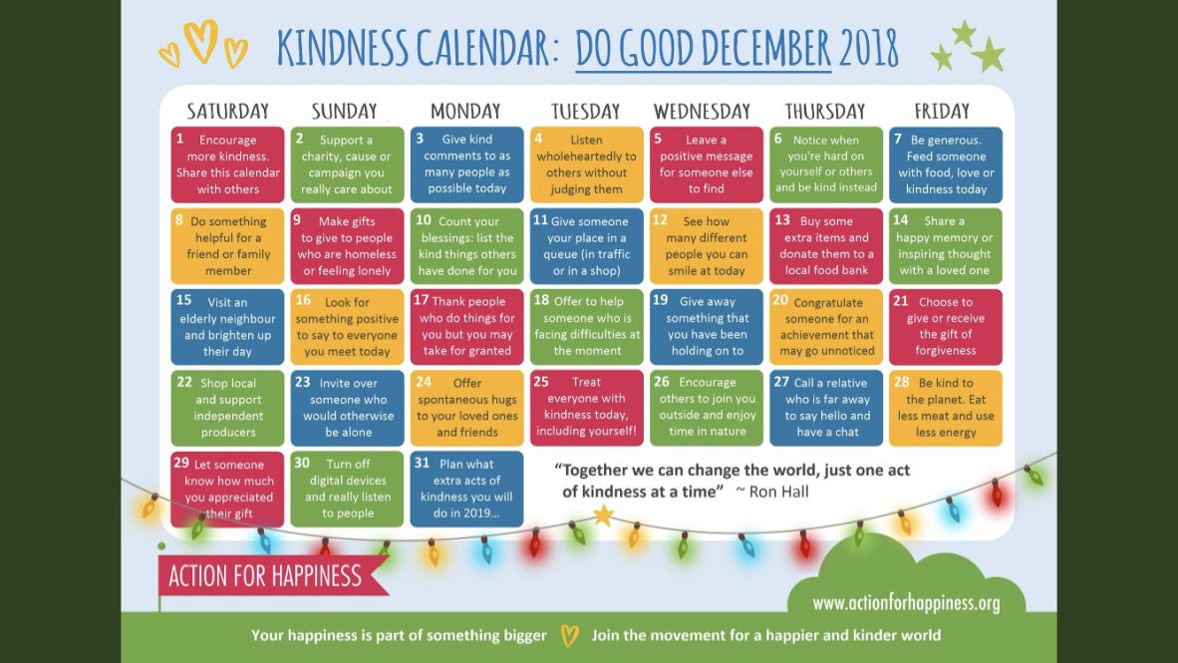

Slide 13

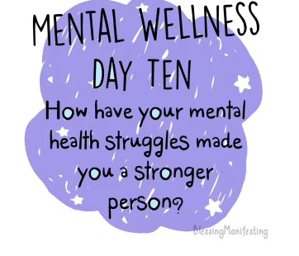


Slide 14


Slide 15
Notes:
Bad questions get bad responses

Slide 16

Notes:
F’d Up, Insecure, Neurotic, and Emotional
So now what?

Slide 17
Know your action plan
Know your limits
Know what you are required to report
Resources on campus
Resources in the community
Have information readily available
Cell phone contacts, folder in office, ……..

Slide 18
9 Healthy Ways to Communicate (stirFry seminars)
Reflect back what is being said. Use their words, not yours.
Begin where they are, not where you want them to be.
Be curious and open to what they are trying to say.
Notice what they are saying AND what they are not.
Emotionally relate to how they are feeling and nurture the relationship.
Notice how you are feeling. Be honest and authentic.
Take responsibility for your part in the conflict or misunderstanding.
Try to understand how their past affects who they are and how those experiences affect their relationship with you.
Stay with the process and relationship, not just the solution.
Notes:
If uncomfortable – then raise a flag in starfish

Slide 19
The Art of mindful inquiry
What I heard you say was……
Tell me more about what you meant by…….
What angered you about what happened?
What hurt you about what happened?
What’s familiar about what happened? How did that affect you? How does it affect you now?
What do you need/want?
The Art of Mindful Facilitation, Lee Mun Wah

Slide 20
Questions to start your student appointments
What has been the best part of the semester so far?
What are you proud of?
What else has been going well?
What has been the biggest challenge?
In what ways can I be the most helpful for you today?

Slide 21
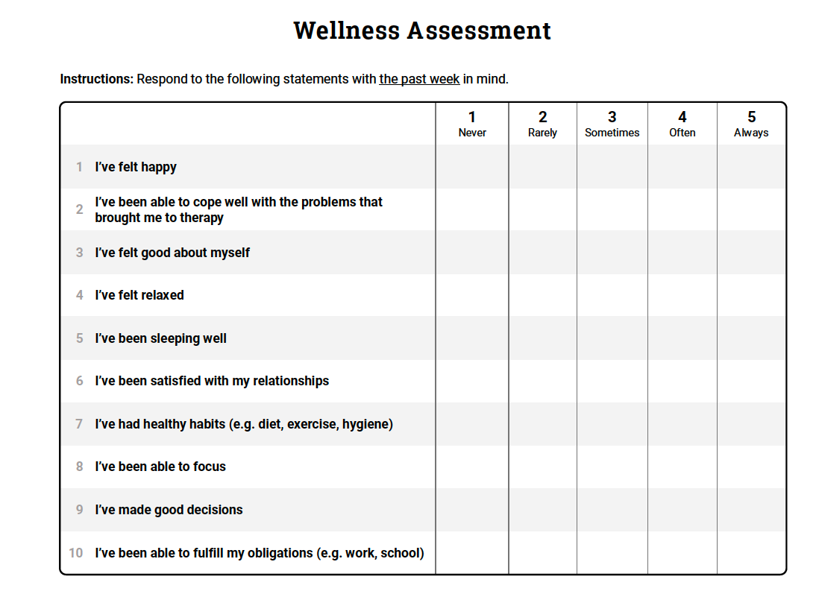
Where do I start?

Slide 22
Mental Health: Depression and Anxiety

Slide 23
Relationship violence and sexual assault
Title IX and Sexual Assault Response and Prevention
The University has resources available for students who have experienced sexual or interpersonal misconduct, which can include sexual harassment, sexual assault, dating violence, and stalking, for example. Some resources are legally confidential, which means personal information will not be shared with anyone else. Other non-confidential (yet still private) resources can explain how to locate support resources, file a complaint within the university, or file criminal charges – these non-confidential resources need to share incidents of sexual and interpersonal misconduct with the Title IX Coordinator. As an instructor, I am non-confidential; however, please know that sharing with the university does not mean the individual must participate in a formal university or criminal process; an individual could request confidentiality through the University, for example. Other services the university can provide include safety planning, counseling, disability or immigration services and assistance in academic and housing accommodations as needed.
University contacts:
Resources and reporting options can be found on the Title IX webpage at www.drake.edu/titleix.
Violence Intervention Partner (V.I.P.) provides peer-based 24/7 confidential support and advocacy services.
To access a V.I.P. advocate call or text 515-512-2972.
NEW HIRE SOON, Title IX Coordinator: 271-2982 or titleix@drake.edu
Lynn Cornelius, Violence Prevention Coordinator, prevention@drake.edu or ext 4141.

Slide 24
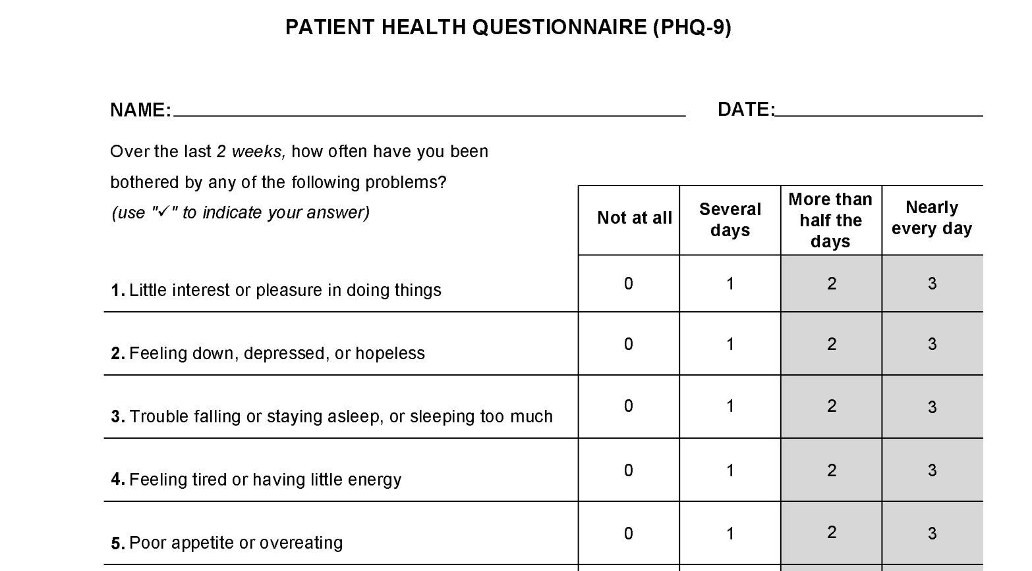
How to re-word when talking with others

Slide 25
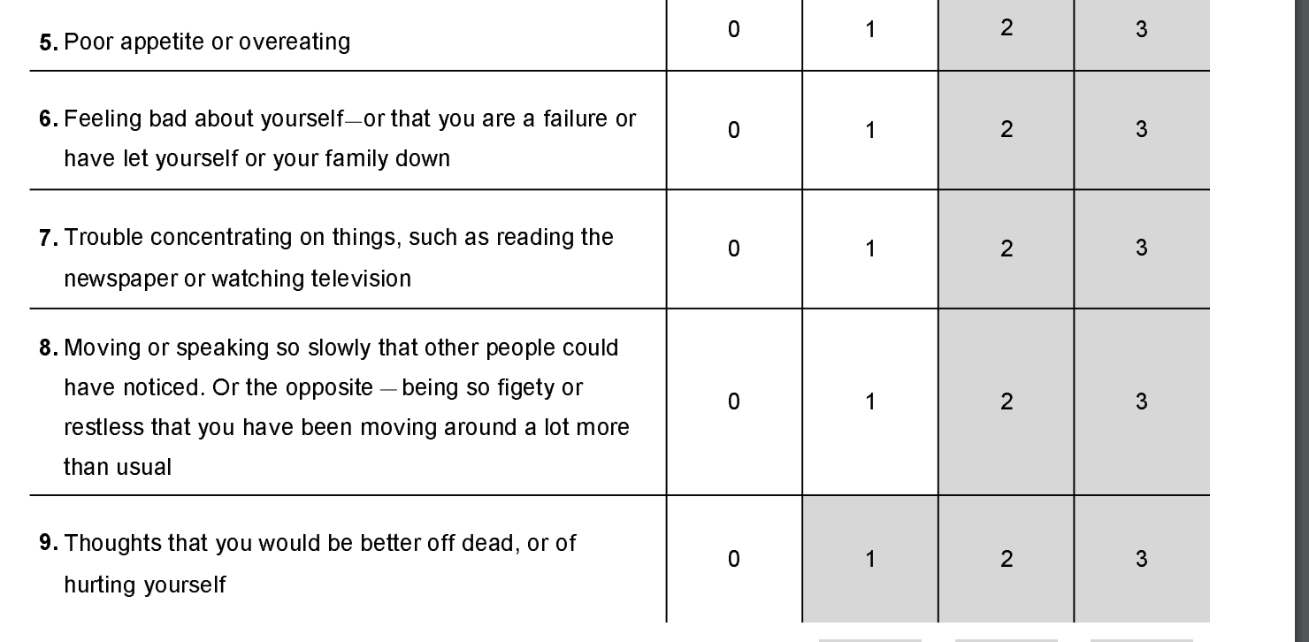

Slide 26
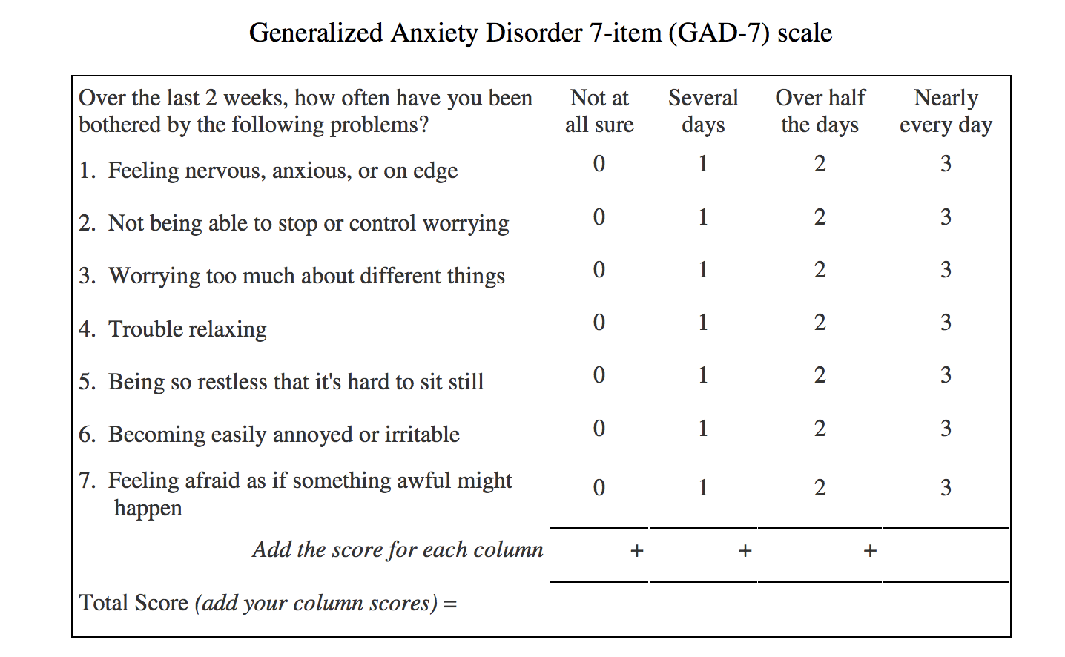

Slide 27
The University Counseling Center (UCC)
The Counseling Center offers to all currently enrolled Drake students a variety of counseling services. Depending on the student's need, individual, couple, family, or group counseling may be provided. The UCC is available for workshops, training, psychological testing, and for referral information. In addition, we offer consultation services to students, staff, and faculty who might have questions about student mental health issues or topics.
Drake University Counseling Center
3116 Carpenter Avenue
Des Moines, Iowa 50311
(515) 271-3864
Hours:
M-Th from 8:30am to 5:00pm, Friday 8:30 to 3pm
http://www.drake.edu/counselingcenter/

Slide 28
Put these contact numbers in your phone….now
Crisis Text Line (Text HELLO to 741741): Drake is partnering with the nationally known group, Crisis Text Line, to provide an additional service for our students. Crisis Text Line Counselors graduate from a 30-hour program that includes: video modules that cover (a) specific skills such as good contact techniques; and (b) issues such as self-harm, suicide, depression, bullying, and LGBTQ issues, as well as quizzes, role plays, and observations shifts. Their training has been vetted by representatives from national organizations like American Foundation for Suicide Prevention, and RAINN (Rape, Abuse, and Incest National Network). This is a free and confidential service. Remember, if this is an emergency, please contact Drake Public Safety at 515-271-2222 or 9-1-1.

Slide 29
After Hours care
Students who need emergency mental health care when the University Counseling Center is closed should call Drake Public Safety at 515-271-2222 or 911. All off-campus treatment is the financial responsibility of the student however the Observation Center is free of charge.
The Crisis Observation Center is intended to meet the needs of individuals who are experiencing an acute behavioral health stressor that impairs the individual’s capacity to cope with his/her normal activities of daily living. The goal of the Crisis Observation Center is to offer a place for individuals to seek crisis intervention services and stabilize them quickly so they can return to the community. The length of stay is up to 23 hours. Services offered include a nursing assessment, care/service coordination, crisis intervention therapy, and access to a psychiatric prescriber if needed. Staff include registered nurses, Master’s level psychotherapists, psychiatric technicians, and care/service. These services are offered in a safe and supportive environment. Crisis Observation Center – open 24/7. Broadlawns Hospital, West entrance, 1801 Hickman, DM Phone: 515-282-5742
Lutheran Hospital is a local center for inpatient psychiatric services.
Mercy Hospital Access to treatment for mental health illness or substance abuse is available 24 hours a day, seven days a week by calling the Mercy Help Center at (515) 271-6111 or toll-free (800) 595-4959.

Slide 30
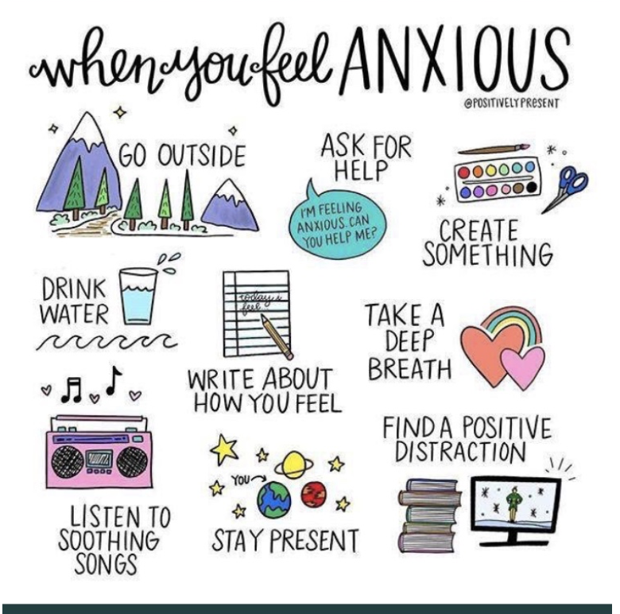

What may work for you?
Who can you contact for support?
Identify your social supports

Slide 31
Mental Health: Alcohol/Substance use disorders

Slide 32
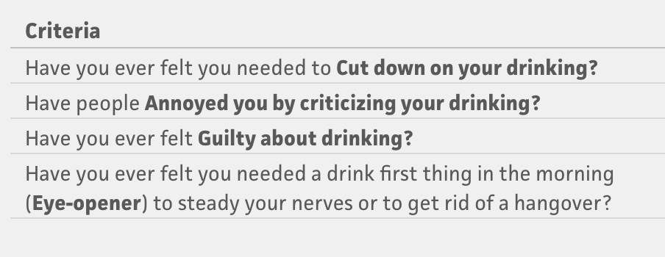
Alcohol: CAGE Questions

Slide 33
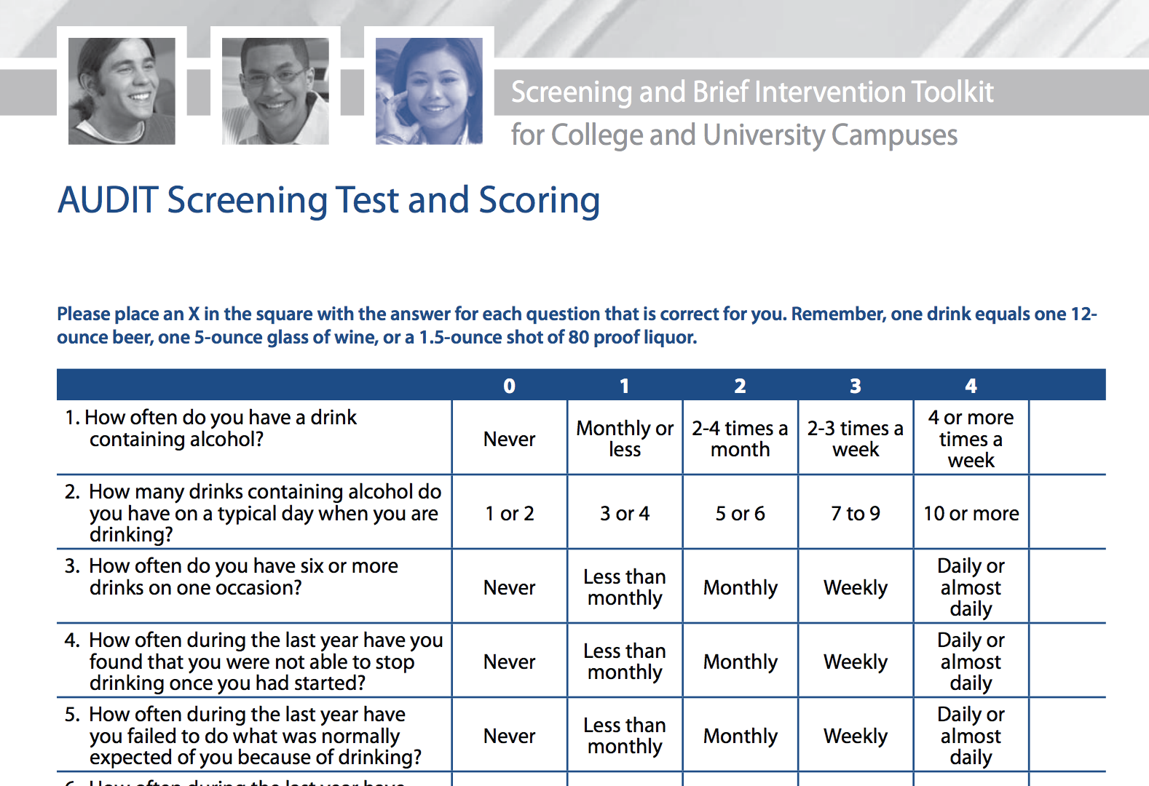

Alcohol: AUDIT

Slide 34
Mental Health: Stress

Slide 35
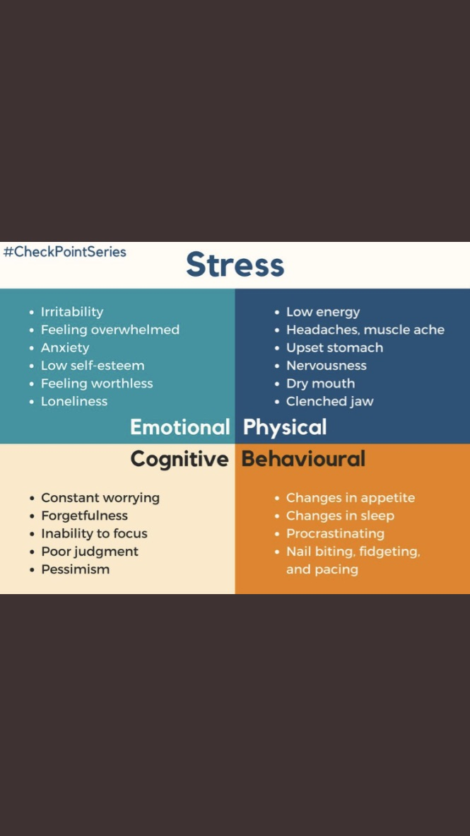

Slide 37
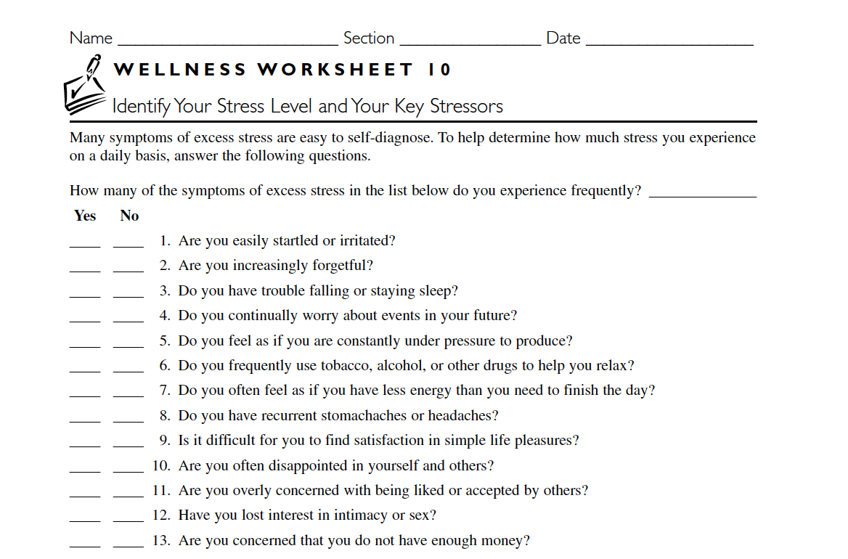

Slide 38
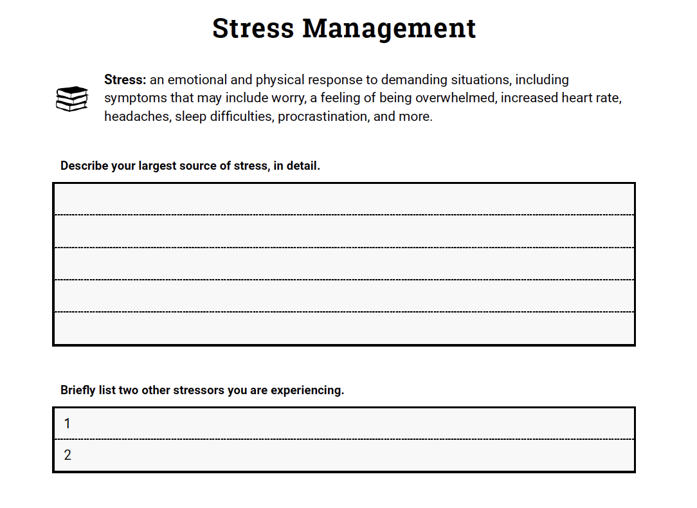

Slide 39
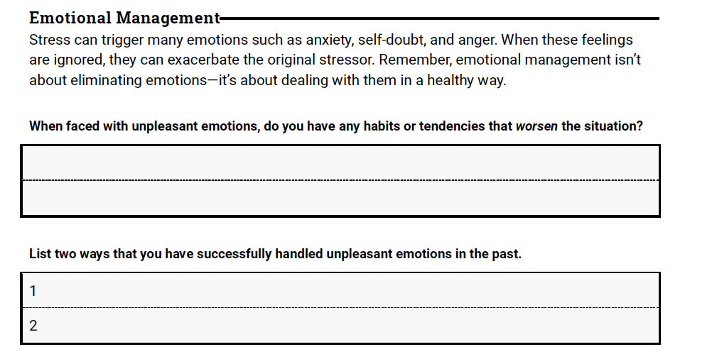

Slide 40


Slide 41
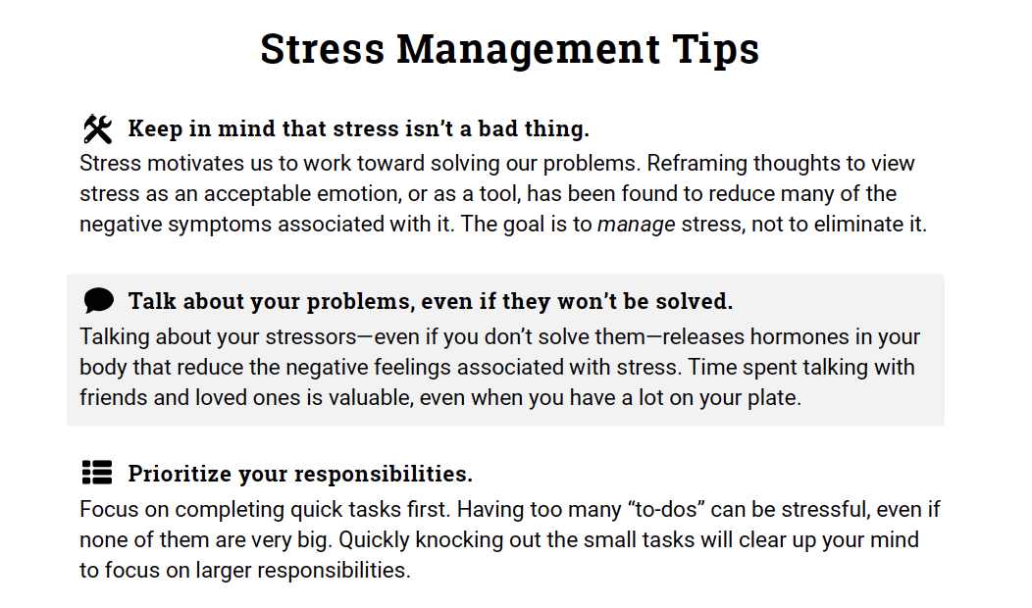

Slide 42
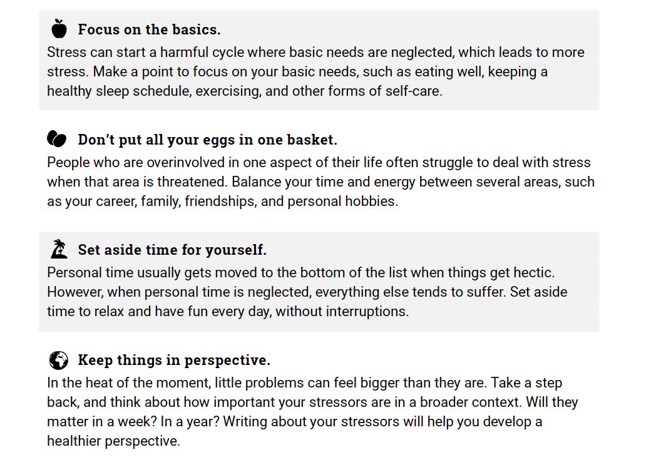

Slide 43

Self-Care

Slide 44
Sometimes things have to fall apart to fall into place

Slide 45

Sometimes it is your responsibility to say “No”

Slide 46

What do you do for self-care?
Not the same for everyone!

Slide 47
You can’t determine what works for others – help them brainstorm.
Just because you run doesn’t mean I want to train for a marathon

Slide 48



Slide 49
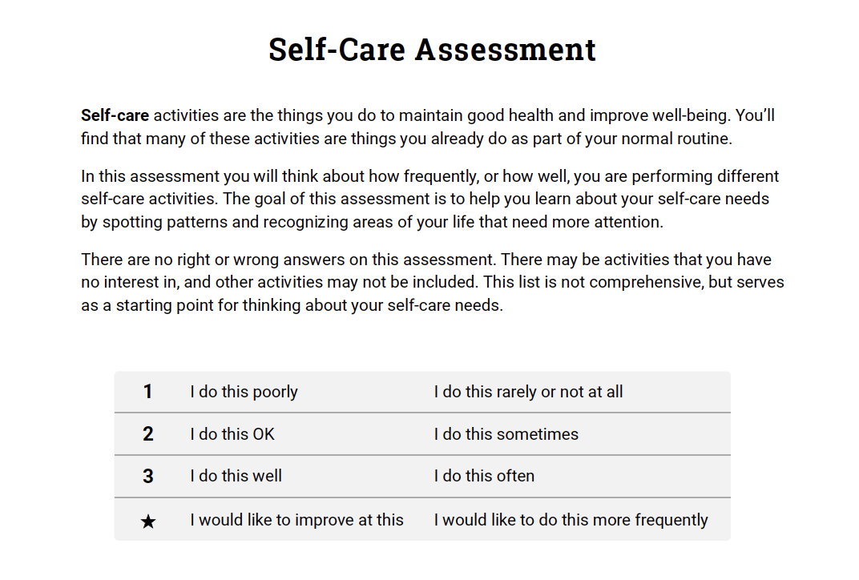

Slide 50
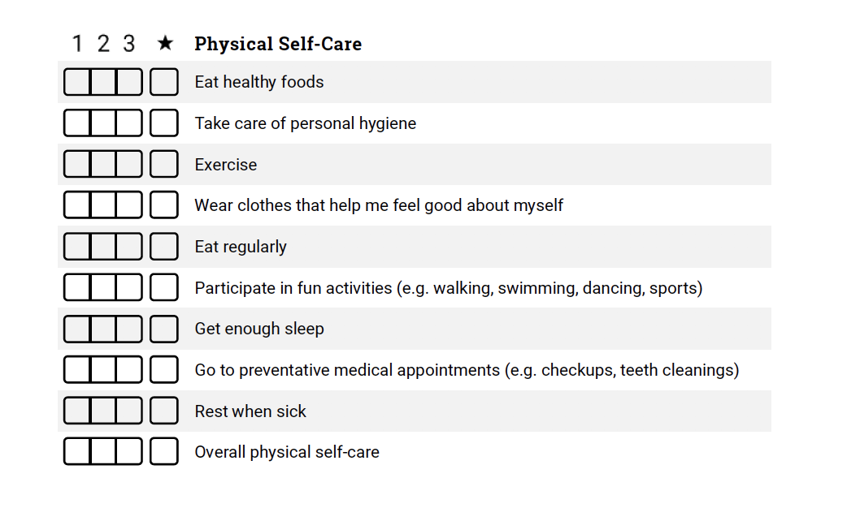

Slide 51
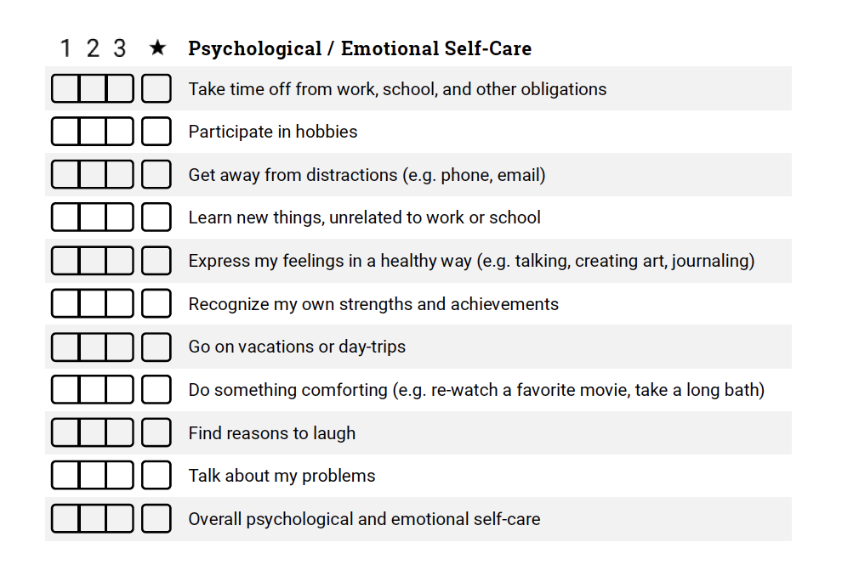

Slide 52
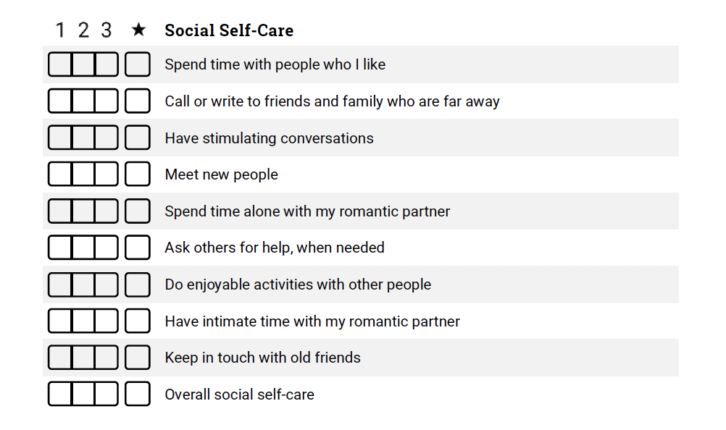

Slide 53
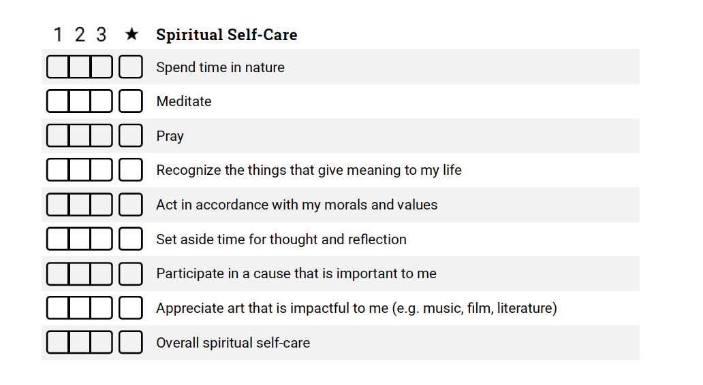

Slide 54
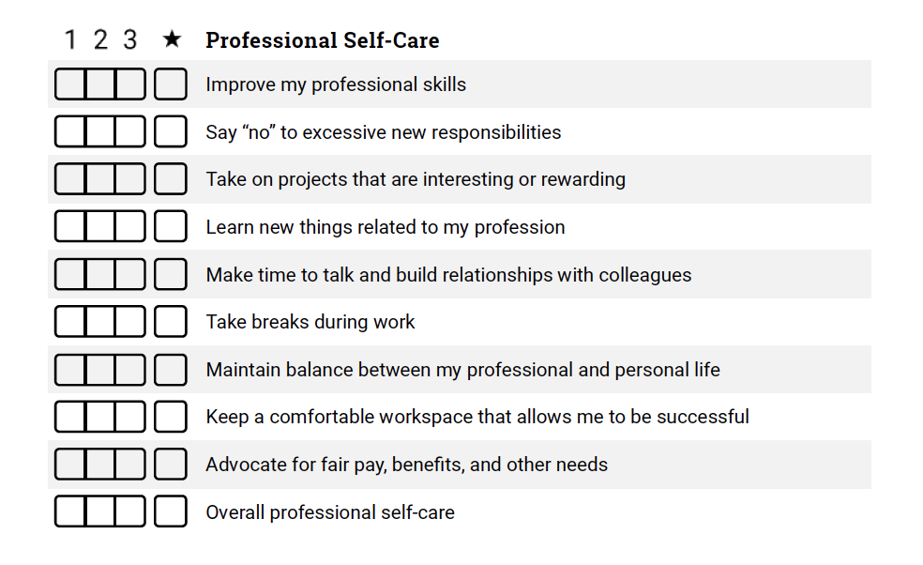

Slide 55
Time-Management

Slide 56
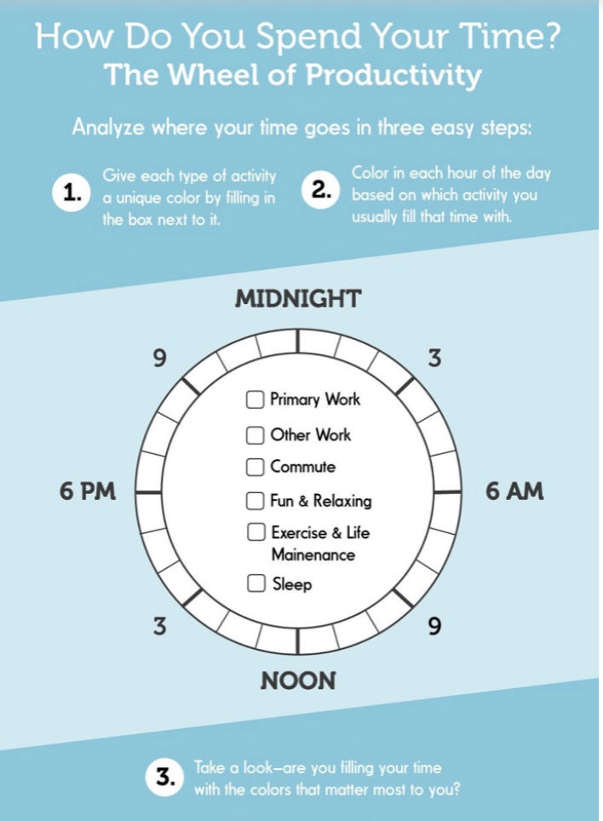
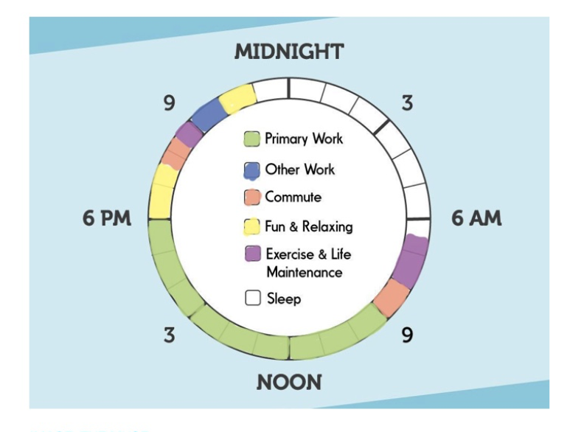

Slide 57
Implement and meet at the end of the time frame

Slide 58
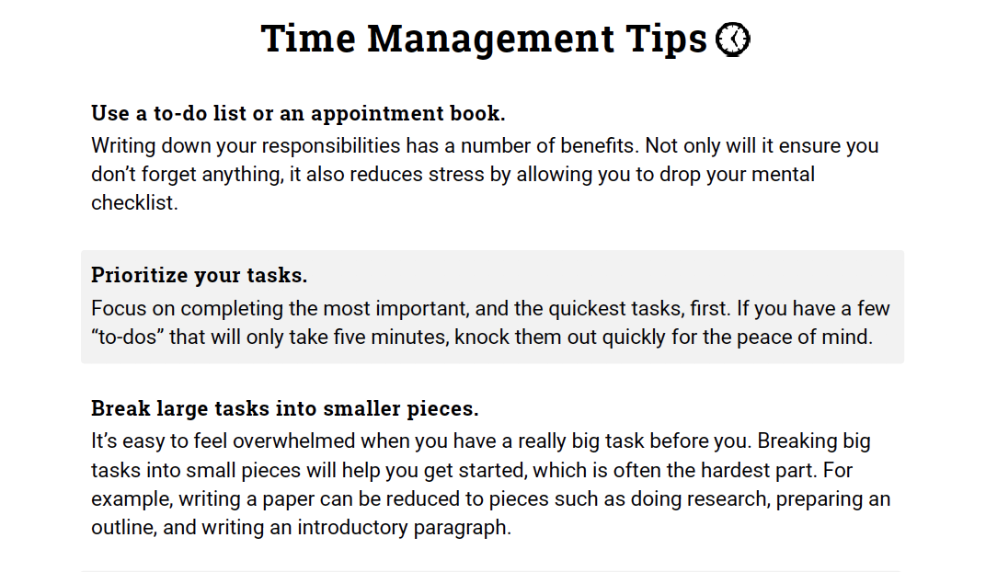

Slide 59
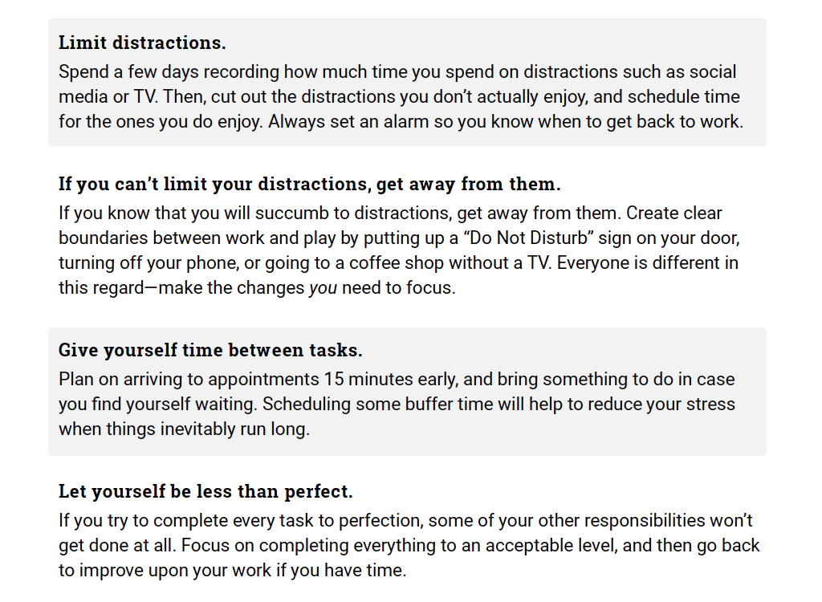
Fringe Time

Slide 60


